Slide 1
Microsoft Visual C#: An Introduction to Object-Oriented Programming
7th Edition
Chapter 13
Handling Events
© 2018 Cengage. All Rights Reserved. May not be copied, scanned, or duplicated, in whole or in part, except for use as permitted in a license distributed with a certain product or service or otherwise on a password-protected website for classroom use.

Slide 2
Objectives
13.1 Describe event handling
13.2 Describe delegates
13.3 Declare and use both custom and built-in event handlers
13.4 Handle Control component events
13.5 Handle mouse and keyboard events
13.6 Manage multiple Controls
13.7 Continue your exploration of Controls and events
© 2018 Cengage. May not be copied, scanned, or duplicated, in whole or in part, except for use as permitted in a license distributed with a certain product or service or otherwise on a password-protected website for classroom use.

Slide 3
Event Handling (1 of 6)
Event
A reaction to an occurrence in a program
Occurs when something interesting happens to an object
Actions that occur during program execution occur at runtime
Event driven
An event “drives” the program to perform a task
Events can be raised, fired, or triggered
Event handler
A method that performs a task in response to an event
© 2018 Cengage. May not be copied, scanned, or duplicated, in whole or in part, except for use as permitted in a license distributed with a certain product or service or otherwise on a password-protected website for classroom use.

Slide 4
Event Handling (2 of 6)
Example: When a user clicks a button, you want the text on the label to change from Hello to Goodbye with the following code:
private void ChangeButton_Click(object sender, EventArgs e)
{
helloLabel.Text = “Goodbye”;
}
Event sender
The object that generates an event (such as a Button)
Event receiver
The event-handling method
© 2018 Cengage. May not be copied, scanned, or duplicated, in whole or in part, except for use as permitted in a license distributed with a certain product or service or otherwise on a password-protected website for classroom use.

Slide 5
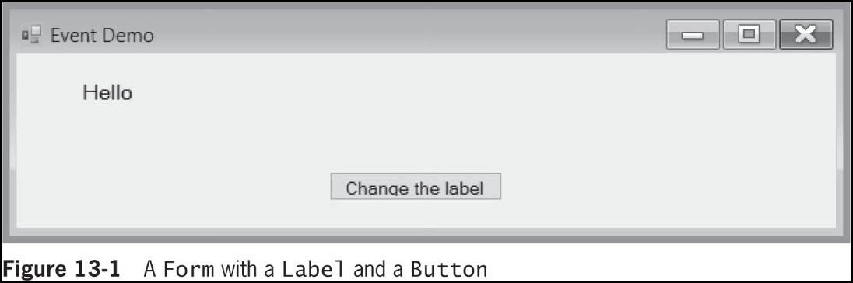
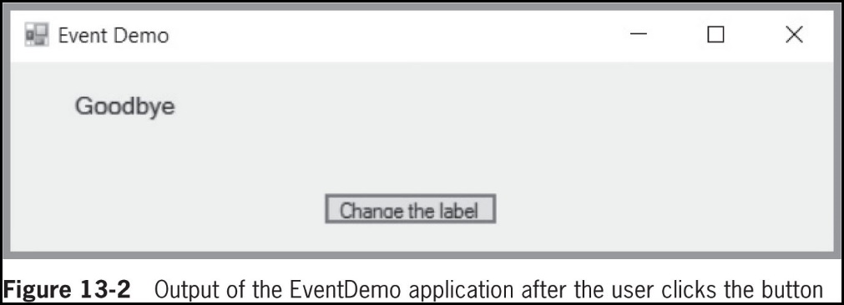
Event Handling (3 of 6)
© 2018 Cengage. May not be copied, scanned, or duplicated, in whole or in part, except for use as permitted in a license distributed with a certain product or service or otherwise on a password-protected website for classroom use.

Slide 6
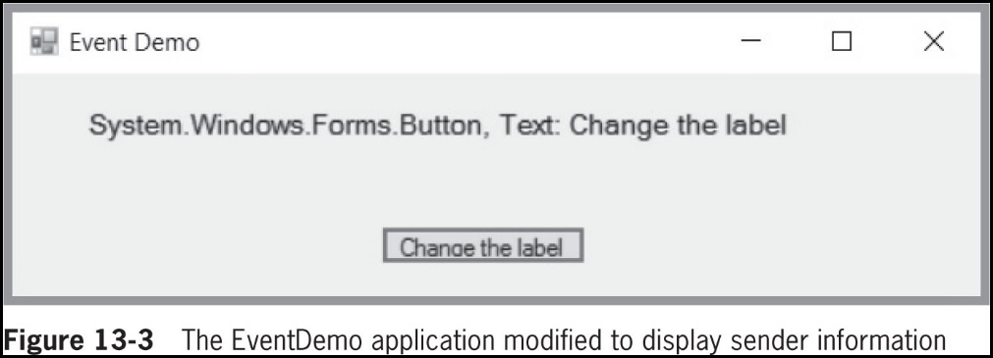
Event Handling (4 of 6)
This event handler displays the sender’s information
© 2018 Cengage. May not be copied, scanned, or duplicated, in whole or in part, except for use as permitted in a license distributed with a certain product or service or otherwise on a password-protected website for classroom use.

Slide 7
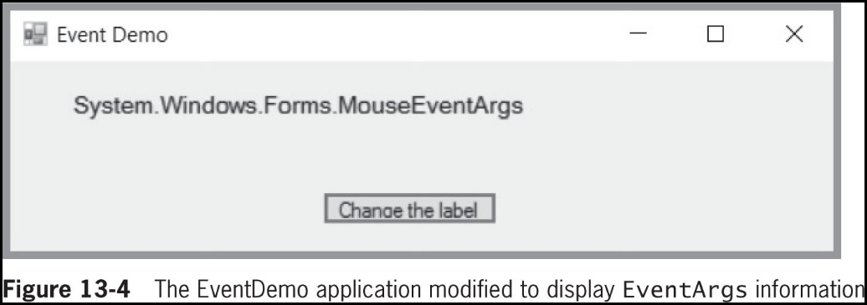
Event Handling (5 of 6)
The e object is a MouseEventArgs object
The user used the mouse to click the Button
© 2018 Cengage. May not be copied, scanned, or duplicated, in whole or in part, except for use as permitted in a license distributed with a certain product or service or otherwise on a password-protected website for classroom use.

Slide 8
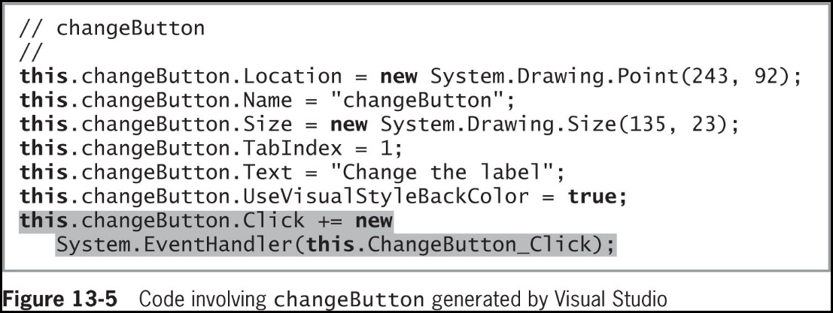
Event Handling (6 of 6)
Click event
An action is fired when a user clicks a button during program execution
Event wiring
Connecting an event to its resulting actions
© 2018 Cengage. May not be copied, scanned, or duplicated, in whole or in part, except for use as permitted in a license distributed with a certain product or service or otherwise on a password-protected website for classroom use.

Slide 9
Understanding Delegates (1 of 3)
Delegate
An object that contains a reference to a method
Encapsulates a method
Provides a way for a program to take alternative courses when running
You can pass a delegate to a method, which can call the method referenced within the delegate
Declare a delegate using the keyword delegate
Followed by an ordinary method declaration that includes a return type, method name, and parameter list
© 2018 Cengage. May not be copied, scanned, or duplicated, in whole or in part, except for use as permitted in a license distributed with a certain product or service or otherwise on a password-protected website for classroom use.

Slide 10
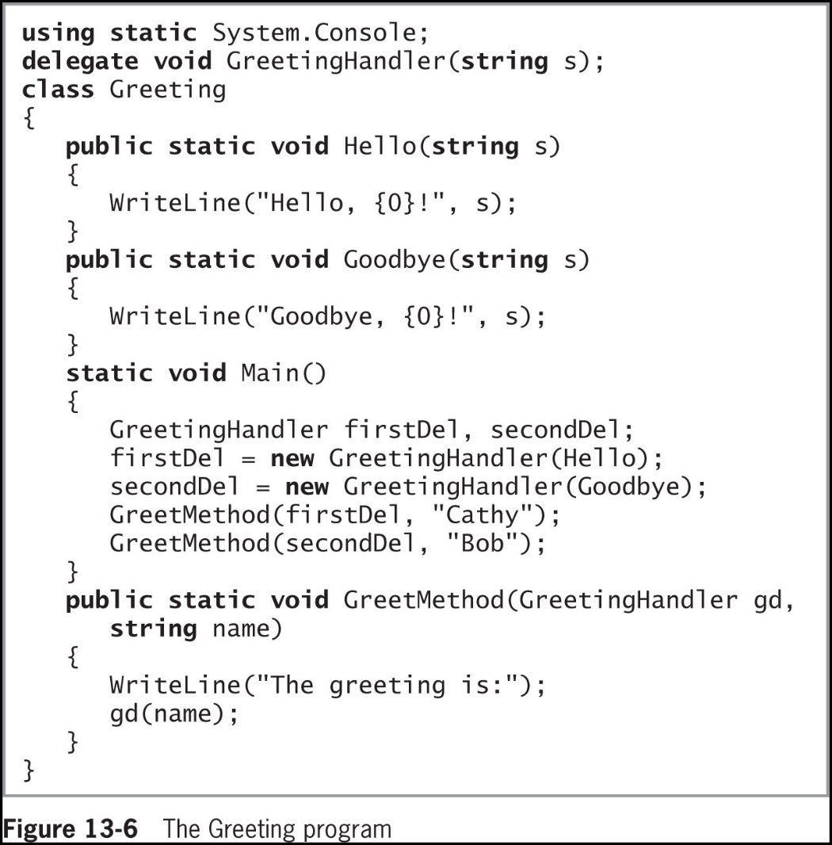
Understanding Delegates (2 of 3)
© 2018 Cengage. May not be copied, scanned, or duplicated, in whole or in part, except for use as permitted in a license distributed with a certain product or service or otherwise on a password-protected website for classroom use.

Slide 11
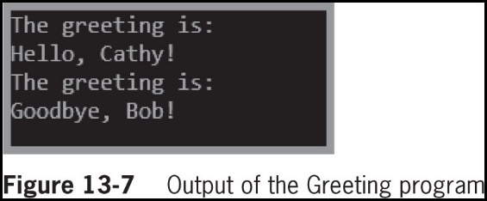
Understanding Delegates (3 of 3)
© 2018 Cengage. May not be copied, scanned, or duplicated, in whole or in part, except for use as permitted in a license distributed with a certain product or service or otherwise on a password-protected website for classroom use.

Slide 12
Creating Composed Delegates (1 of 3)
Assign one delegate to another using the = operator
Use the + and += operators to combine delegates into a composed delegate
Calls the delegates from which it is built
Figure 13-8 (next slide) shows a program that contains a composed delegate
© 2018 Cengage. May not be copied, scanned, or duplicated, in whole or in part, except for use as permitted in a license distributed with a certain product or service or otherwise on a password-protected website for classroom use.

Slide 13
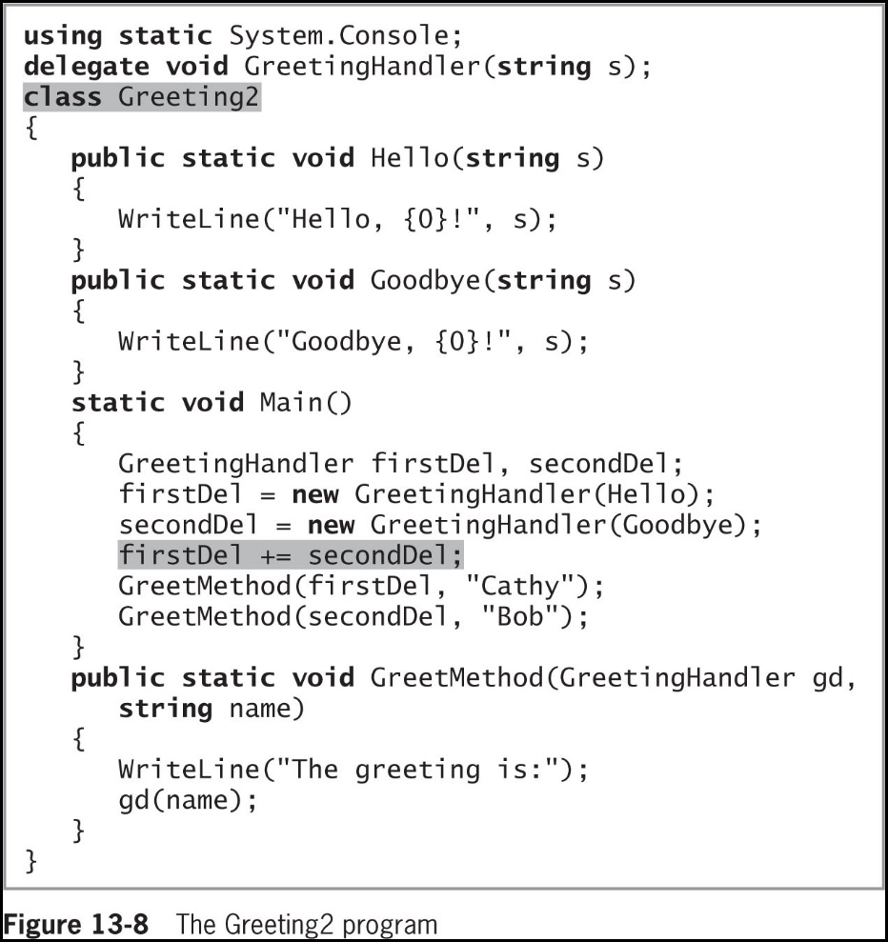
Creating Composed Delegates (2 of 3)
© 2018 Cengage. May not be copied, scanned, or duplicated, in whole or in part, except for use as permitted in a license distributed with a certain product or service or otherwise on a password-protected website for classroom use.

Slide 14
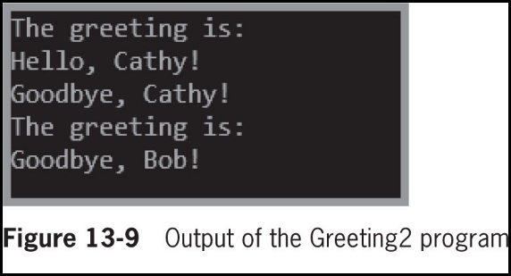
Creating Composed Delegates (3 of 3)
© 2018 Cengage. May not be copied, scanned, or duplicated, in whole or in part, except for use as permitted in a license distributed with a certain product or service or otherwise on a password-protected website for classroom use.

Slide 15
Declaring and Using Both Custom and Built-in Event Handlers (1 of 7)
Declare your own event using a delegate
An event provides a way for a class’s clients to dictate methods that should execute when an event occurs
Example:
public delegate void ChangedEventHandler(object sender, EventArgs e);
© 2018 Cengage. May not be copied, scanned, or duplicated, in whole or in part, except for use as permitted in a license distributed with a certain product or service or otherwise on a password-protected website for classroom use.

Slide 16
Declaring and Using Both Custom and Built-in Event Handlers (2 of 7)
Figure 13-12 (next slide) contains the ChangedEventHandler delegate and a simple Student class
The Student class contains just two data fields and generates an event when the data in either field changes
The first shaded statement defines a third attribute of the Student class—an event named Changed
© 2018 Cengage. May not be copied, scanned, or duplicated, in whole or in part, except for use as permitted in a license distributed with a certain product or service or otherwise on a password-protected website for classroom use.

Slide 17
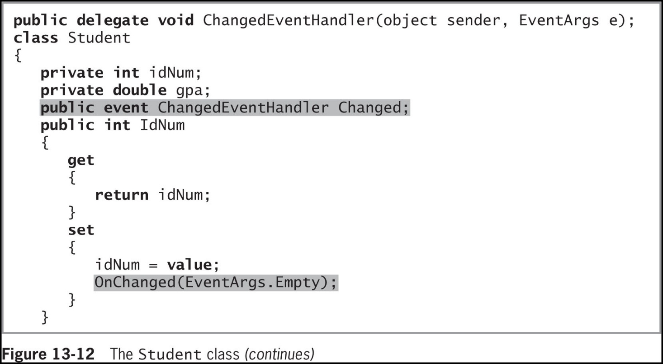
Declaring and Using Both Custom and Built-in Event Handlers (3 of 7)
© 2018 Cengage. May not be copied, scanned, or duplicated, in whole or in part, except for use as permitted in a license distributed with a certain product or service or otherwise on a password-protected website for classroom use.

Slide 18
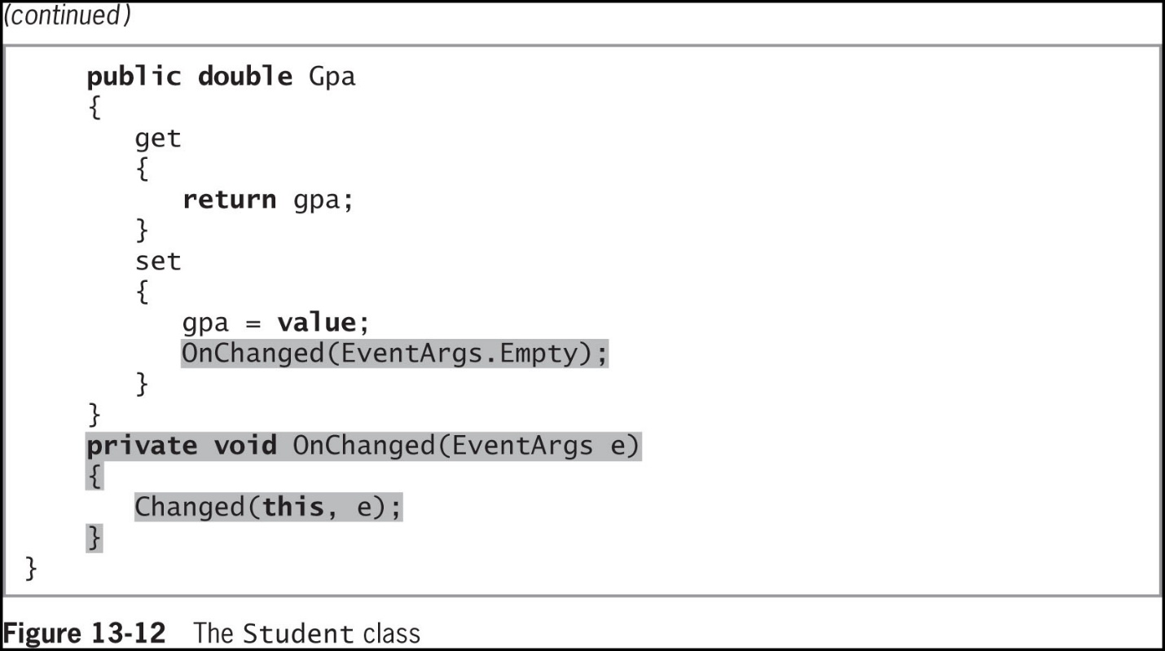
Declaring and Using Both Custom and Built-in Event Handlers (4 of 7)
© 2018 Cengage. May not be copied, scanned, or duplicated, in whole or in part, except for use as permitted in a license distributed with a certain product or service or otherwise on a password-protected website for classroom use.

Slide 19
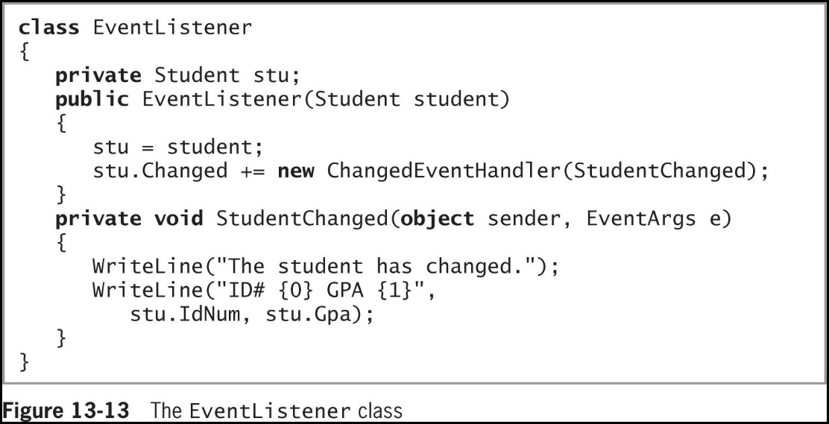
Declaring and Using Both Custom and Built-in Event Handlers (5 of 7)
Figure 13-13 shows an EventListener class that listens for Student events
© 2018 Cengage. May not be copied, scanned, or duplicated, in whole or in part, except for use as permitted in a license distributed with a certain product or service or otherwise on a password-protected website for classroom use.

Slide 20
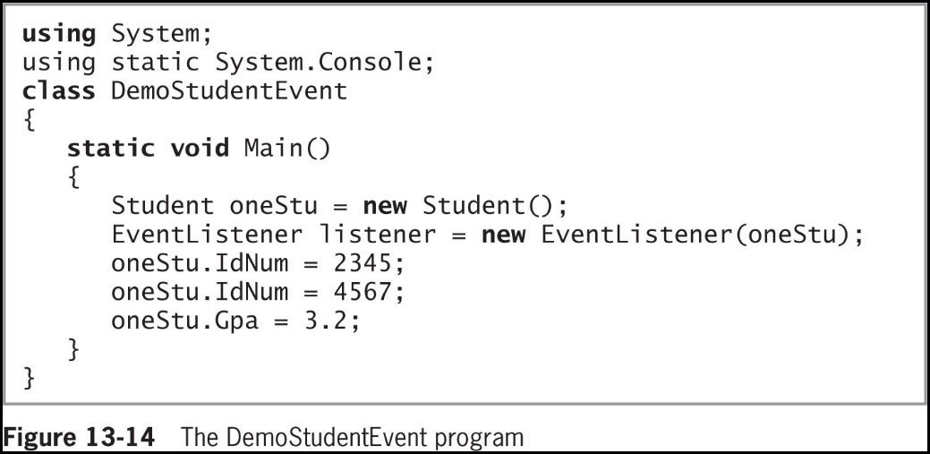
Declaring and Using Both Custom and Built-in Event Handlers (6 of 7)
Figure 13-14 shows a program that demonstrates using the Student and EventListener classes
© 2018 Cengage. May not be copied, scanned, or duplicated, in whole or in part, except for use as permitted in a license distributed with a certain product or service or otherwise on a password-protected website for classroom use.

Slide 21
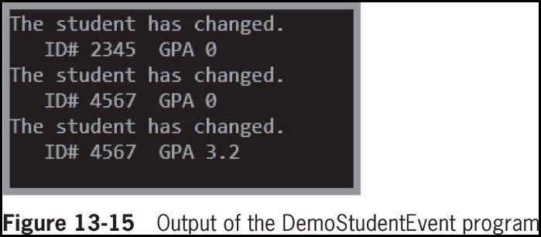
Declaring and Using Both Custom and Built-in Event Handlers (7 of 7)
© 2018 Cengage. May not be copied, scanned, or duplicated, in whole or in part, except for use as permitted in a license distributed with a certain product or service or otherwise on a password-protected website for classroom use.

Slide 22
Using the Built-in EventHandler (1 of 3)
The .NET Framework provides guidelines to follow if you are developing a class that others will use
The delegate type for an event takes two parameters:
The source of the event
The EventArgs parameter
EventHandler
Defined by the .NET Framework
For events that do not use additional information
© 2018 Cengage. May not be copied, scanned, or duplicated, in whole or in part, except for use as permitted in a license distributed with a certain product or service or otherwise on a password-protected website for classroom use.

Slide 23
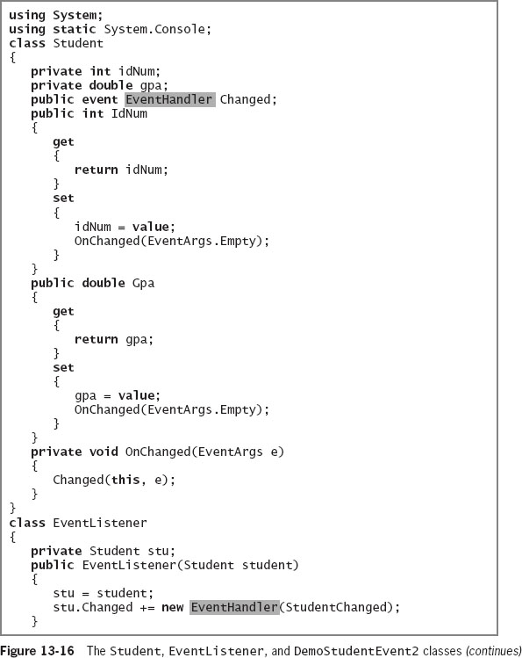
Using the Built-in EventHandler (2 of 3)
© 2018 Cengage. May not be copied, scanned, or duplicated, in whole or in part, except for use as permitted in a license distributed with a certain product or service or otherwise on a password-protected website for classroom use.

Slide 24
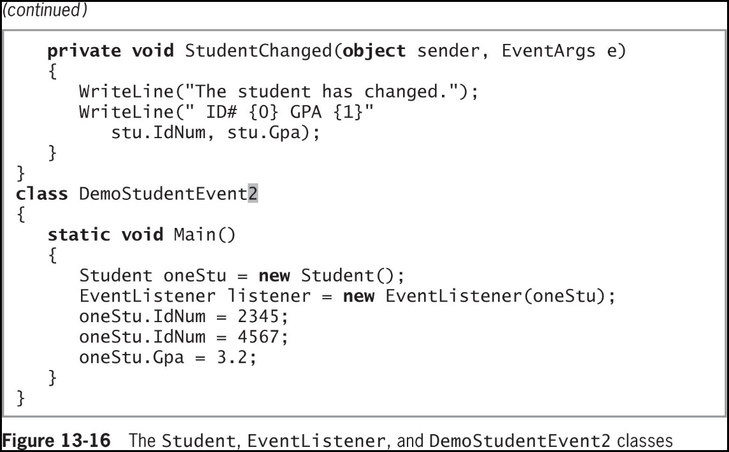
Using the Built-in EventHandler (3 of 3)
© 2018 Cengage. May not be copied, scanned, or duplicated, in whole or in part, except for use as permitted in a license distributed with a certain product or service or otherwise on a password-protected website for classroom use.

Slide 25
Handling Control Component Events (1 of 3)
Existing Control components already have events with names
To handle events generated by GUI Controls, you use the same techniques as when you handle any other events
The major difference is that when you create your own classes, like Student, you must define both the data fields and events you want to manage
Existing Control components, like Buttons and ListBoxes, already contain fields and public properties, like Text, as well as events with names, like Click
© 2018 Cengage. May not be copied, scanned, or duplicated, in whole or in part, except for use as permitted in a license distributed with a certain product or service or otherwise on a password-protected website for classroom use.

Slide 26
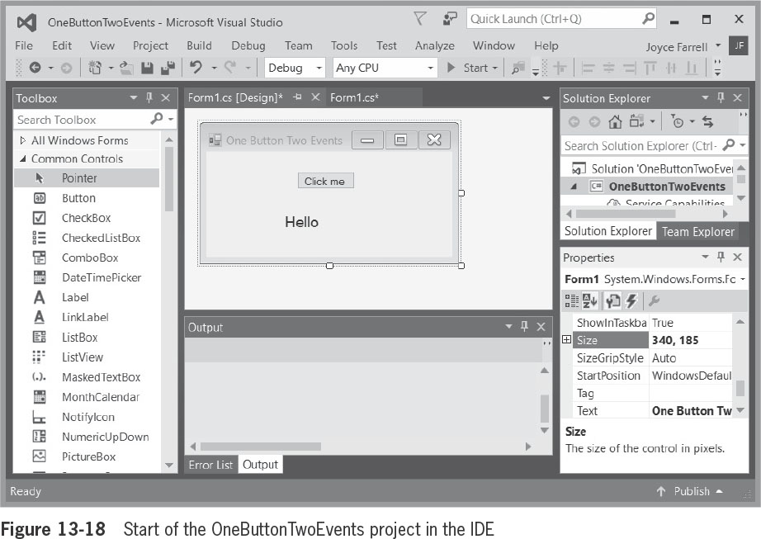
Handling Control Component Events (2 of 3)
A Form can contain any number of Controls that might have events associated with them
A single Control might be able to raise any number of events like mouse events
© 2018 Cengage. May not be copied, scanned, or duplicated, in whole or in part, except for use as permitted in a license distributed with a certain product or service or otherwise on a password-protected website for classroom use.

Slide 27
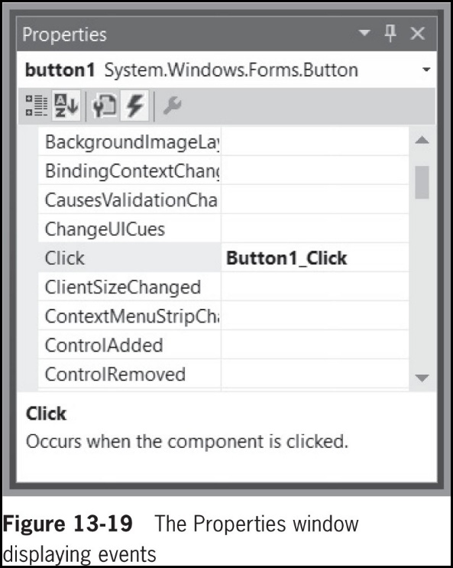
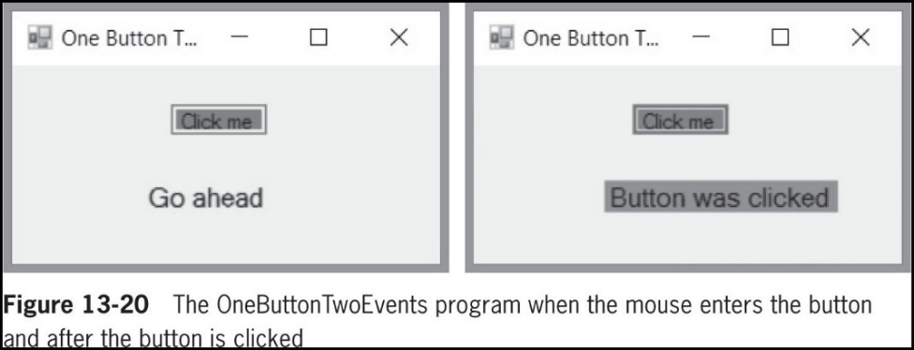
Handling Control Component Events (3 of 3)
© 2018 Cengage. May not be copied, scanned, or duplicated, in whole or in part, except for use as permitted in a license distributed with a certain product or service or otherwise on a password-protected website for classroom use.

Slide 28
Handling Mouse and Keyboard Events
Two common ways users interact with GUI applications:
To use a mouse
To type on a keyboard
Mouse and keyboard event-handling method must have two parameters:
An object representing the sender
An object that holds information about the event
© 2018 Cengage. May not be copied, scanned, or duplicated, in whole or in part, except for use as permitted in a license distributed with a certain product or service or otherwise on a password-protected website for classroom use.

Slide 29
Handling Mouse Events (1 of 2)
Mouse events
Actions a user takes with a mouse
Includes clicking, pointing, and dragging
Handled through an object of the class MouseEventArgs
MouseEventHandler
The delegate used to create mouse event handlers
© 2018 Cengage. May not be copied, scanned, or duplicated, in whole or in part, except for use as permitted in a license distributed with a certain product or service or otherwise on a password-protected website for classroom use.

Slide 30
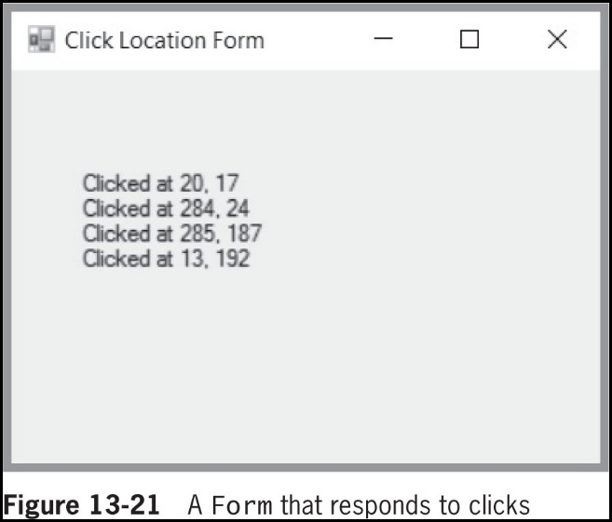
Handling Mouse Events (2 of 2)
© 2018 Cengage. May not be copied, scanned, or duplicated, in whole or in part, except for use as permitted in a license distributed with a certain product or service or otherwise on a password-protected website for classroom use.

Slide 31
Handling Keyboard Events (1 of 3)
Keyboard events are also known as key events
Key events occur when the user presses and releases keyboard keys
KeyEventHandler and KeyPressEventHandler
Delegates used to create the keyboard event handler
KeyEventArgs and KeyPressEventArgs
Classes used to handle key events
© 2018 Cengage. May not be copied, scanned, or duplicated, in whole or in part, except for use as permitted in a license distributed with a certain product or service or otherwise on a password-protected website for classroom use.

Slide 32
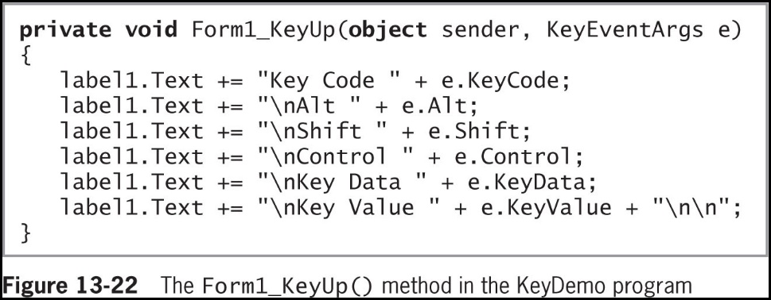
Handling Keyboard Events (2 of 3)
© 2018 Cengage. May not be copied, scanned, or duplicated, in whole or in part, except for use as permitted in a license distributed with a certain product or service or otherwise on a password-protected website for classroom use.

Slide 33
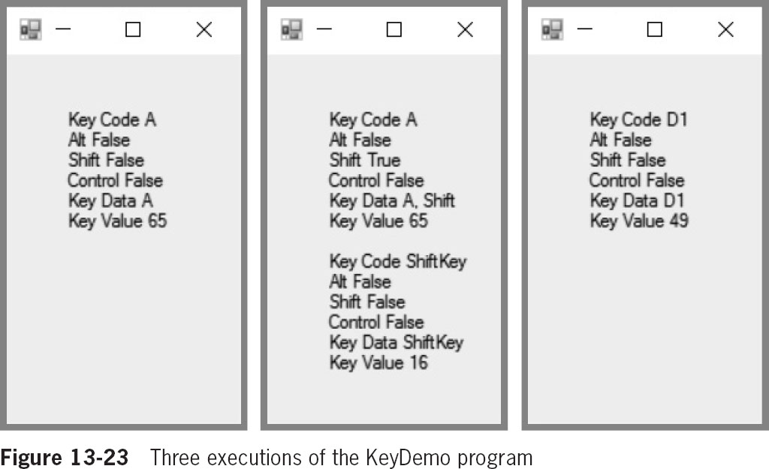
Handling Keyboard Events (3 of 3)
© 2018 Cengage. May not be copied, scanned, or duplicated, in whole or in part, except for use as permitted in a license distributed with a certain product or service or otherwise on a password-protected website for classroom use.

Slide 34
Managing Multiple Controls
When Forms contain multiple Controls, you often want to have focus
You might also want several actions to have a single, shared consequence
© 2018 Cengage. May not be copied, scanned, or duplicated, in whole or in part, except for use as permitted in a license distributed with a certain product or service or otherwise on a password-protected website for classroom use.

Slide 35
Defining Focus (1 of 2)
Focus
A user expects that clicking the button or pressing the Enter key will raise an event
TabStop is a Boolean property that identifies whether the Control will serve as a stopping place in a sequence of Tab key presses
TabIndex is a numeric property that Indicates the order in which the Control will receive focus when the user presses the Tab key
© 2018 Cengage. May not be copied, scanned, or duplicated, in whole or in part, except for use as permitted in a license distributed with a certain product or service or otherwise on a password-protected website for classroom use.

Slide 36
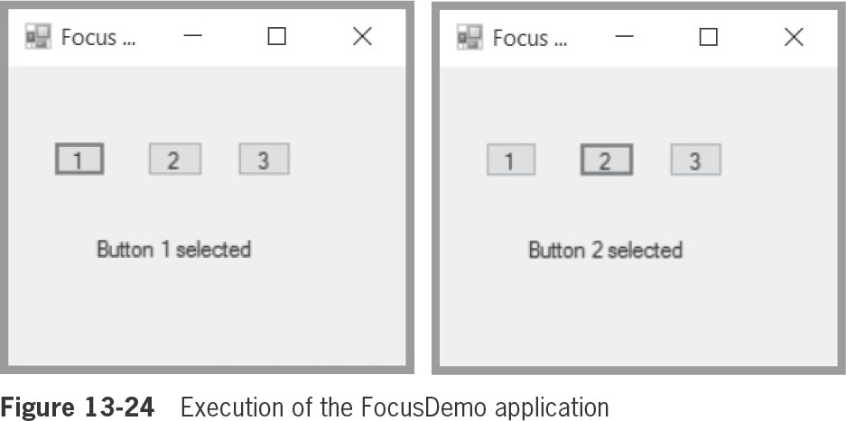
Defining Focus (2 of 2)
Figure 13-24 shows a Form that contains three Buttons and a Label
© 2018 Cengage. May not be copied, scanned, or duplicated, in whole or in part, except for use as permitted in a license distributed with a certain product or service or otherwise on a password-protected website for classroom use.

Slide 37
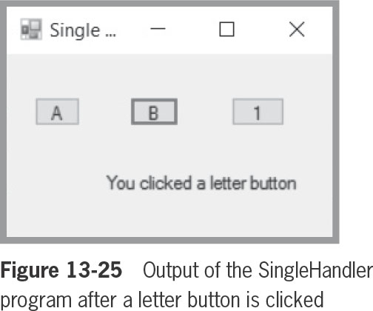
Handling Multiple Events with a Single Handler
You can associate the same event with multiple Controls
Use the Events icons in the Properties window
Displays all the existing events that have the correct signature to be the event handler for the event
© 2018 Cengage. May not be copied, scanned, or duplicated, in whole or in part, except for use as permitted in a license distributed with a certain product or service or otherwise on a password-protected website for classroom use.

Slide 38
Continuing to Learn about Controls and Events
Many additional Controls contain hundreds of properties and events
Learning about each new C# feature becomes progressively easier
Continue to explore the Help facility in the Visual Studio IDE
Read the brief tutorials there
Search the Internet for C# discussion groups
© 2018 Cengage. May not be copied, scanned, or duplicated, in whole or in part, except for use as permitted in a license distributed with a certain product or service or otherwise on a password-protected website for classroom use.

Slide 39
Chapter Summary (1 of 2)
GUI programs are event-driven – a button click raises an event, fires an event, or triggers an event
A method that performs a task in response to an event is an event handler
A delegate is an object that contains a reference to a method
You can assign one delegate to another using the = operator
To declare your own event, use a delegate
The .NET Framework provides guidelines to follow when you develop a class that others will use
© 2018 Cengage. May not be copied, scanned, or duplicated, in whole or in part, except for use as permitted in a license distributed with a certain product or service or otherwise on a password-protected website for classroom use.

Slide 40
Chapter Summary (2 of 2)
Existing Control components contain events
Every mouse or keyboard event-handling method must have two parameters:
An object representing the sender
An object that holds event information
When users encounter multiple GUI Controls on a Form, usually one Control has focus
When you encounter a new control in the IDE, you probably can use it without understanding all the code generated in the background
© 2018 Cengage. May not be copied, scanned, or duplicated, in whole or in part, except for use as permitted in a license distributed with a certain product or service or otherwise on a password-protected website for classroom use.

